Slide 1
Graphic Design Principles

Slide 2
The 7 fundamental principles of design
Emphasis
Balance
Contrast
Repetition
Proportion
Movement
White Space

Slide 3
The 7 fundamental principles of design
Design differs from art in that it has to have a purpose. Visually, this functionality is interpreted by making sure an image has a center of attention, a point of focus.

Slide 4
The 7 fundamental principles of design
Graphic design, like any discipline, adheres to strict rules that work under the surface to make the work stable and balanced. If the design is missing that balance, it will be weak and ineffective.

Slide 5
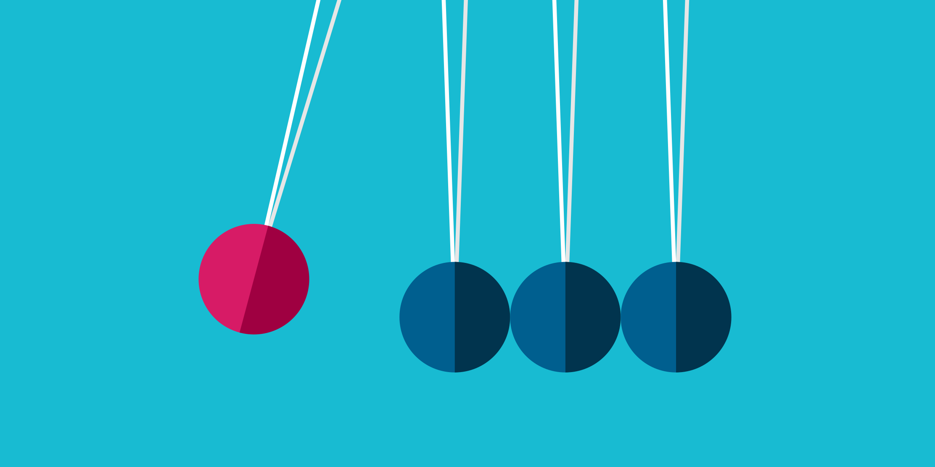
Emphasis
The first of the 7 design principles is emphasis, referring to the focal point of a design and the order of importance of each element within a design.

Slide 6

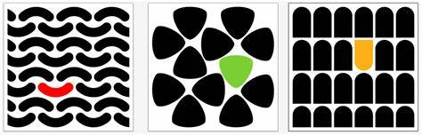
Emphasis

Slide 7
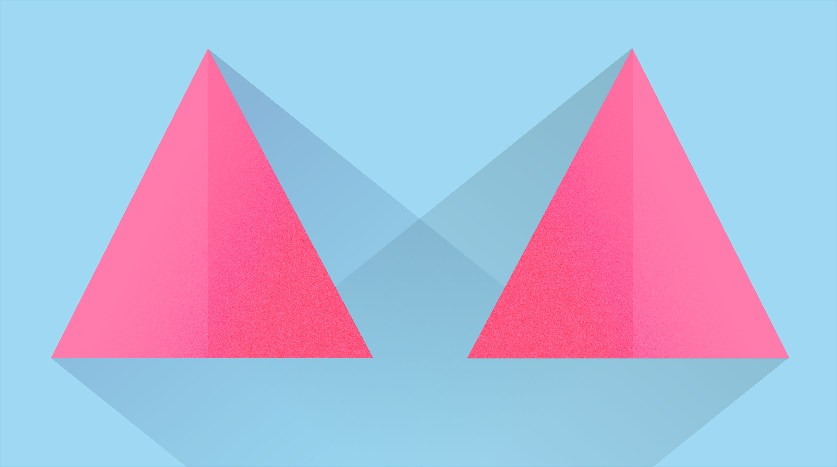
Balance (Symmetrical & Asymmetrical)
Symmetrical design creates balance through equally weighted elements aligned on either side of a center line.

Slide 8
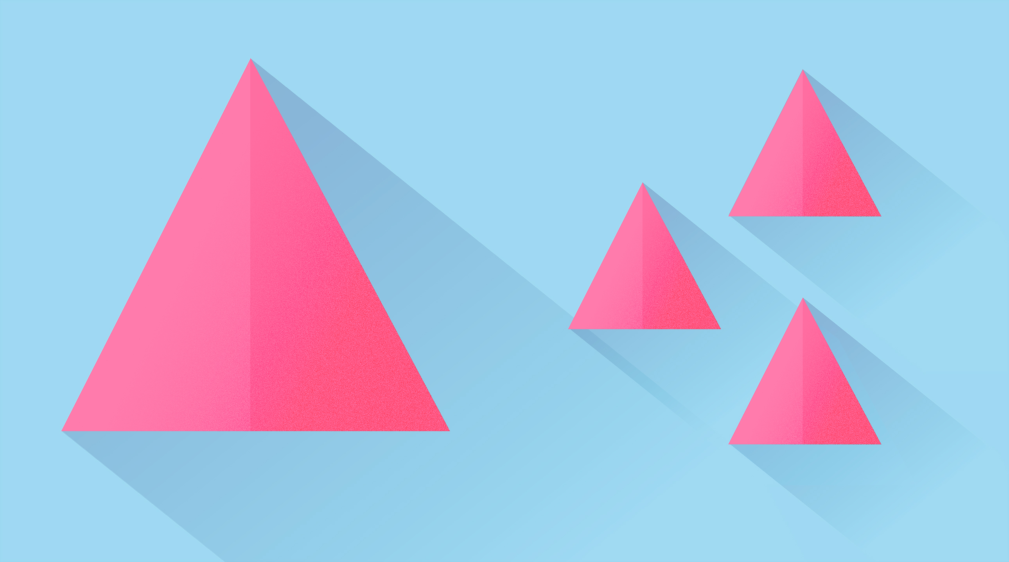
Balance (Symmetrical & Asymmetrical)
Asymmetrical design uses opposite weights (like contrasting one large element with several smaller elements) to create a composition that is not even, but still has equilibrium.

Slide 9
Balance (Symmetrical & Asymmetrical)
Symmetrical design
Asymmetrical design

Slide 10
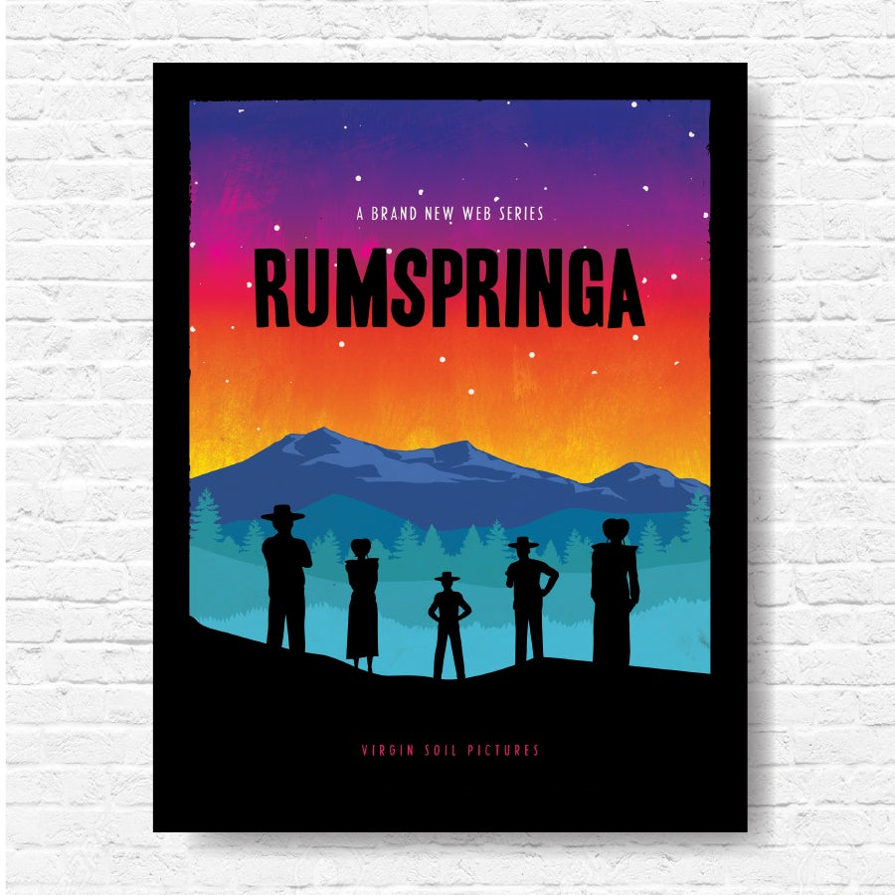
Balance (Symmetrical & Asymmetrical)
Never forget that every element you place on a page has a weight. The weight can come from color, size, or texture.

Slide 11
Balance (Symmetrical & Asymmetrical)
Symmetrical designs are always pleasing, if not occasionally boring. Asymmetrical designs are bolder and can bring real visual interest and movement (more on that later!) to your composition.

Slide 12

Contrast
Contrast creates space and difference between elements in your design. Your background needs to be significantly different from the color of your elements so they work harmoniously together and are readable.

Slide 13
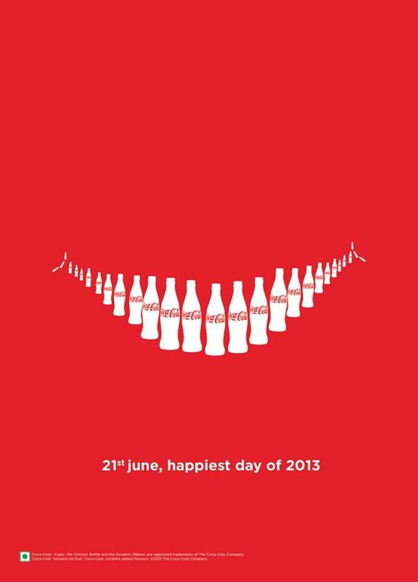
Contrast
If you plan to work with type, understanding contrast is incredibly essential because it means the weight and size of your type are balanced. How will your audience know what is most important if everything is in bold?

Slide 14
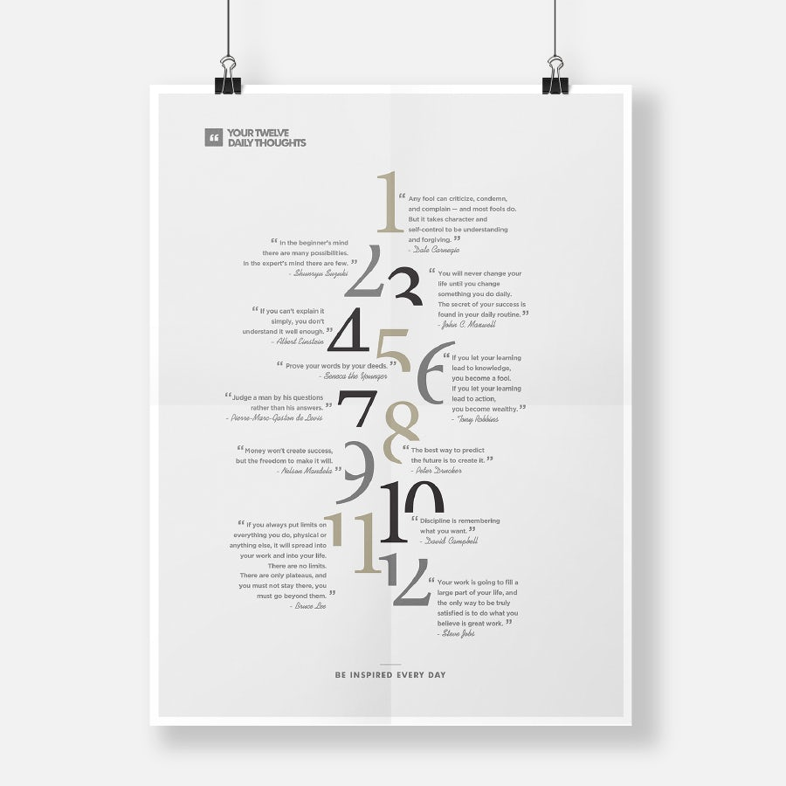
Repetition
If you limit yourself to two strong typefaces or three strong colors, you’ll soon find you’ll have to repeat some things. That’s ok! It’s often said that repetition unifies and strengthens a design.

Slide 15
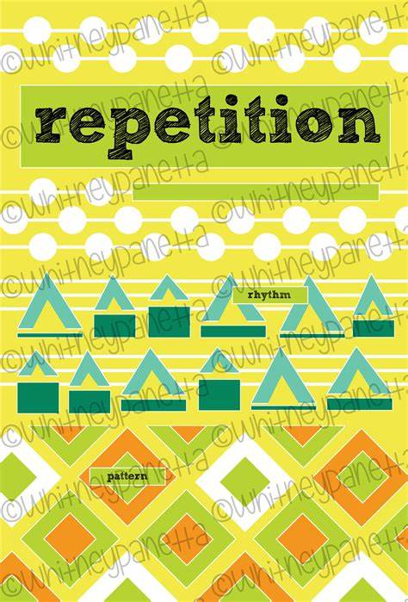
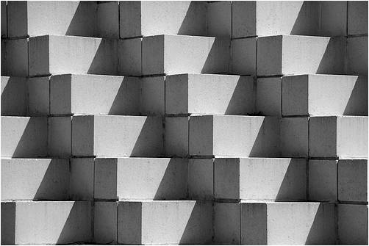
Repetition

Slide 16
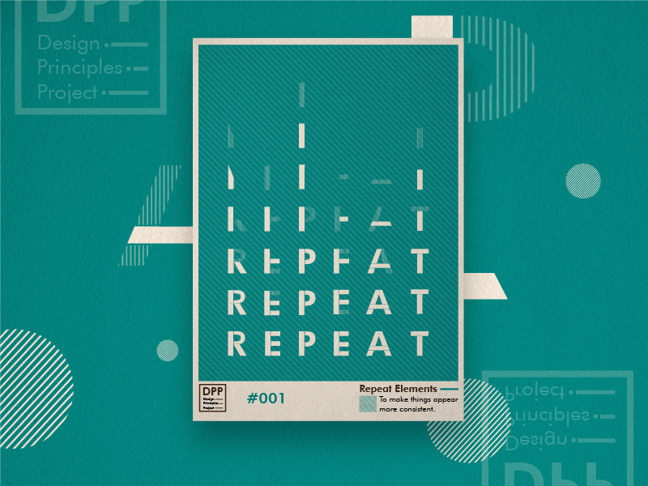
Repetition

Slide 17
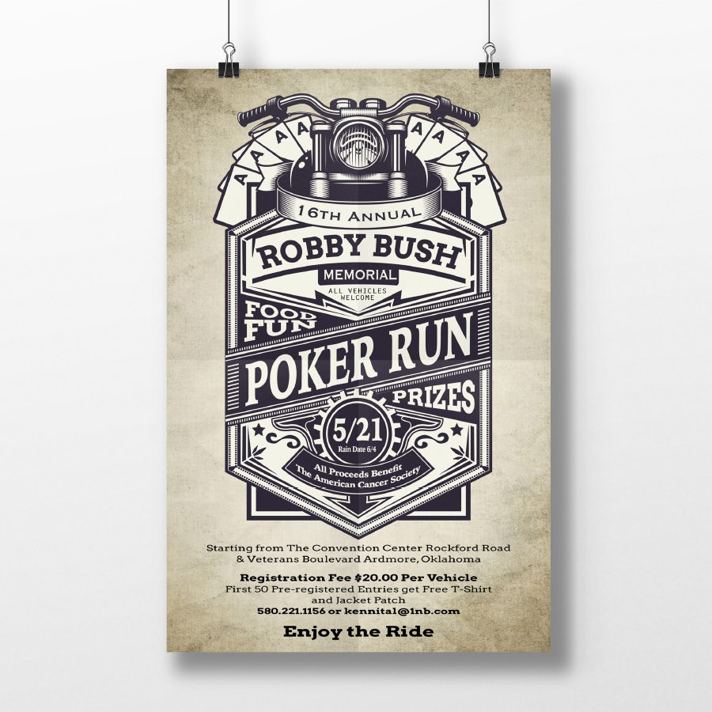
Proportion
Proportion is the visual size and weight of elements in a composition and how they relate to each other. It often helps to approach your design in sections, instead of as a whole.

Slide 18
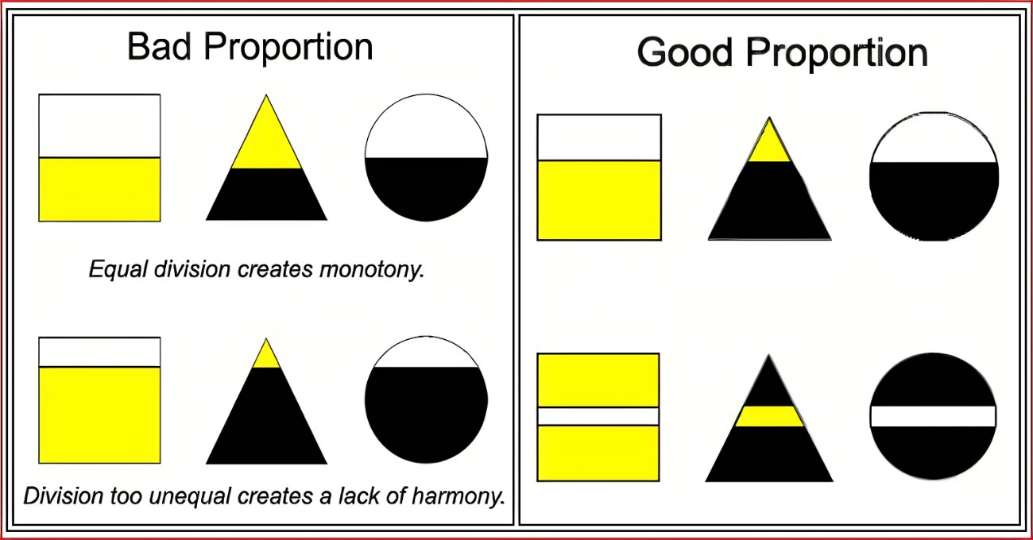
Proportion

Slide 19
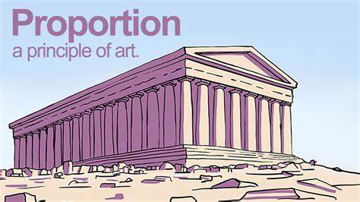
Proportion

Slide 20

Movement
Movement is controlling the elements in a composition so that the eye is led to move from one to the next and the information is properly communicated to your audience.

Slide 21
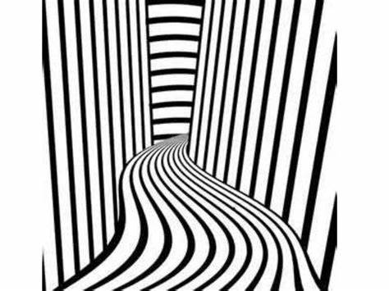
Movement
If you look at your design and feel your eye get “stuck” anywhere on it—an element is too big, too bold, slightly off-center, not a complimentary color—go back and adjust until everything is in harmony.

Slide 22
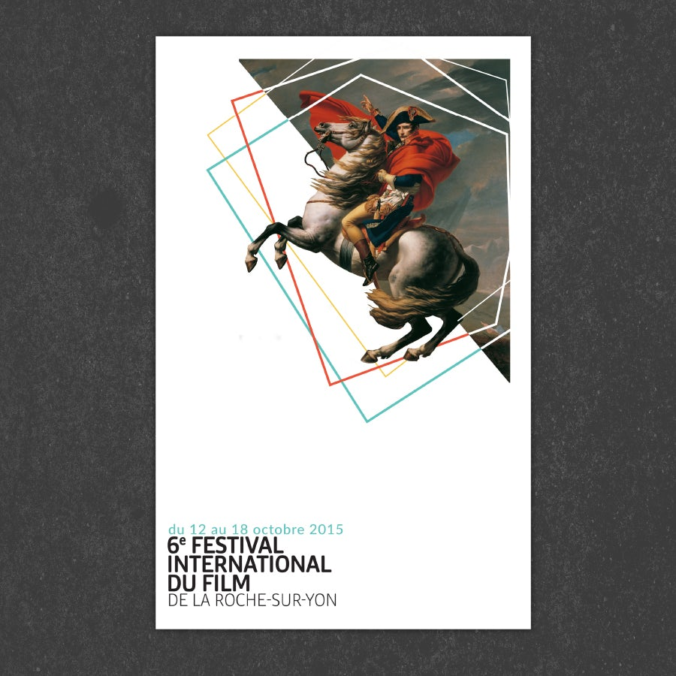
White space
White space is exactly that—the empty page around the elements in your composition. White space isn’t sitting there doing nothing—it’s creating hierarchy and organization.

Slide 23
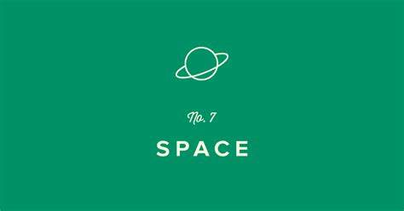
White space
Our brains naturally associate ample white space around an element with importance and luxury. It’s telling our eyes that objects in one region are grouped separately from objects elsewhere.

Slide 24
How to use the principles of design ?
A design doesn’t have to strictly follow these rules to be “good.” Some absolutely mind-blowing designs ignore one or more of the principles of design in order to create an eye-catching and effective work.

